Slide 1



Using Geology to Communicate Radon Potential to the Public
Bethany Overfield, M.S., William Andrews Jr., Ph.D.
University of Kentucky, Kentucky Geological Survey
Lexington, KY
Amanda Wiggins, Ph.D., Ellen J. Hahn, Ph.D., Renee Fox, M.S.
University of Kentucky College of Nursing, BREATHE
Lexington, KY

Slide 2
Outline
Collaboration between Kentucky Geological Survey and UK College of Nursing
The geology of radon
Creation of Radon Potential Maps
Role of geology in assessing radon potential
Future work

Slide 3

BREATHE
Bridging Research Efforts and Advocacy Toward Healthy Environments (BREATHE) is a multidisciplinary research, outreach, and practice collaborative of the UK College of Nursing with partners internal and external to UK.
Mission: is to promote lung health and healthy environments to achieve health equity.
Kentucky Geological Survey (KGS)
The Kentucky Geological Survey is a state supported research center and public resource within the University of Kentucky.
Mission: conduct research and provide unbiased information about geologic resources, environmental issues, and natural hazards affecting Kentucky.

Slide 4

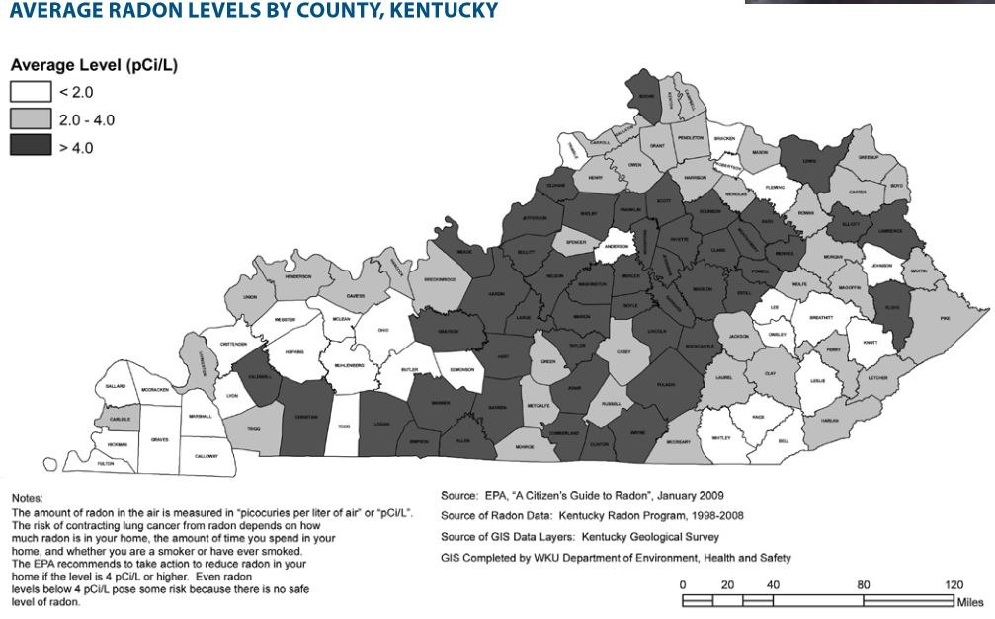
County-based radon map inspired the collaboration between KGS and BREATHE.
Radon data obtained by BREATHE researchers were analyzed by county and zip code; political boundaries are not, however, optimal for describing the extent of physical phenomena.
Radon levels have the potential to vary within a county, based on the context of geology.

Slide 5
Kentucky leads the nation in the incidence of new lung cancer cases and lung cancer mortality.
Radon is the second leading cause of lung cancer.
Those exposed to both radon and tobacco smoke are 10 times more likely to develop lung cancer.
Kentucky has high radon potential (because of the geology), high smoking rates, and weak smoke-free protections.

Slide 6
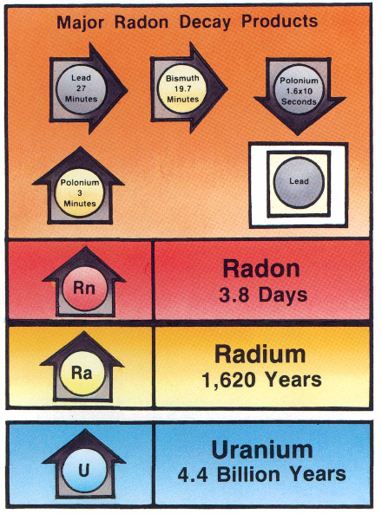
All rocks contain some uranium
Rocks with high Uranium: light colored volcanics, granites, dark shales, sedimentary rocks that contain phosphates, and metamorphic rocks derived from these rocks.
Breakdown of Uranium--------> Radium--------> Radon--------> Polonium--------> Lead
Daughter materials
Parent material
Otton, James, 1992, The Geology of Radon, USGS General Interest pub

Slide 7
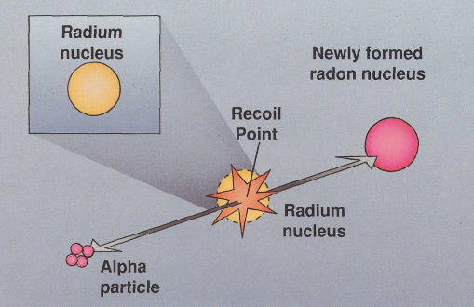

Radium--------> Radon
Radium decays by ejecting an alpha particle (composed of two neutrons and two protons)
As the alpha particle is ejected, the newly formed radon atom recoils and is shot off in the opposite direction!
Alpha recoil most important factor affecting the release of radon from mineral grains in a rock or soil.
Otton, James, 1992, The Geology of Radon, USGS General Interest pub

Slide 8
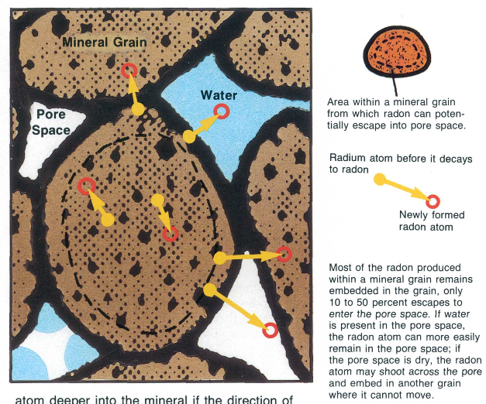
Mineral grains in a rock or soil:
Radon atom can be shot from a mineral grain into:
• the same mineral grain
• another mineral grain
• pore space
• water in pore space
Otton, James, 1992, The Geology of Radon, USGS General Interest pub
Radon that enters pore space becomes available to movement.

Slide 9
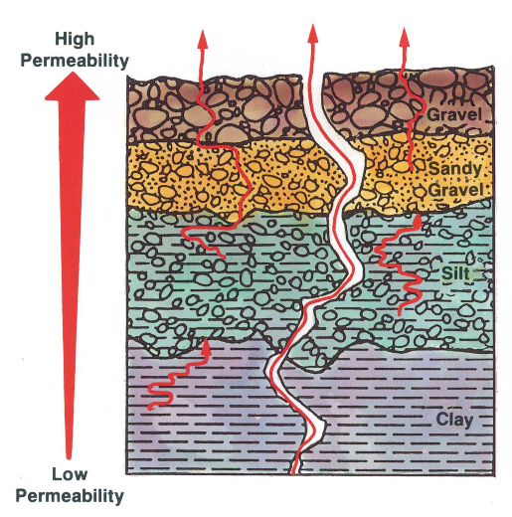
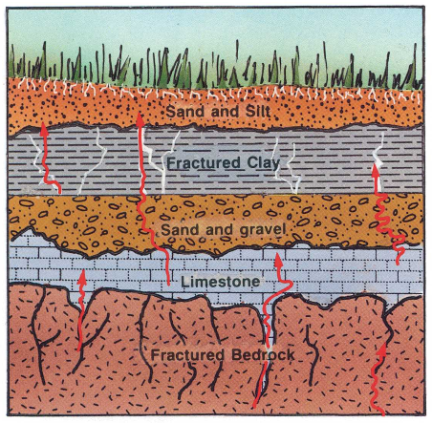
Radon movement
Radon is a gas, which makes it more mobile
It travels through fractures and openings in rock or through pore space
The method and speed of radon movement through rock/soil is controlled by water in the pore space, the % of pore space, and the permeability of rock/soil (“interconnectedness”)
Otton, James, 1992, The Geology of Radon, USGS General Interest pub

Slide 10
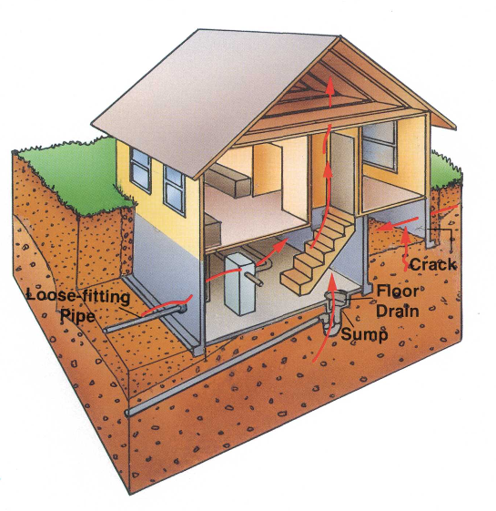
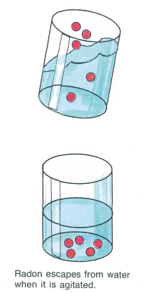
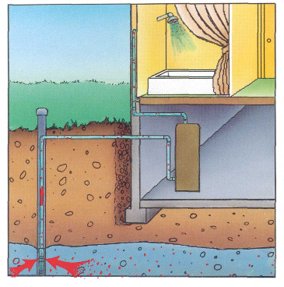
Radon movement
Radon can enter a home through many paths
Groundwater often overlooked as a pathway
Otton, James, 1992, The Geology of Radon, USGS General Interest pub

Slide 11
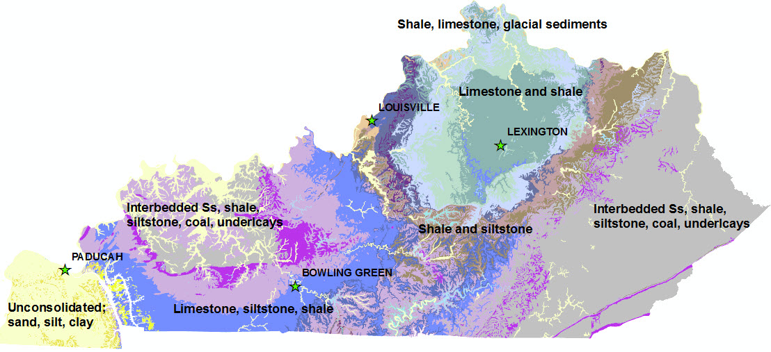
Kentucky has different rock types underneath the surface. Some rocks have the potential to release more radon gas than others based on the amount of uranium in them.

Slide 12
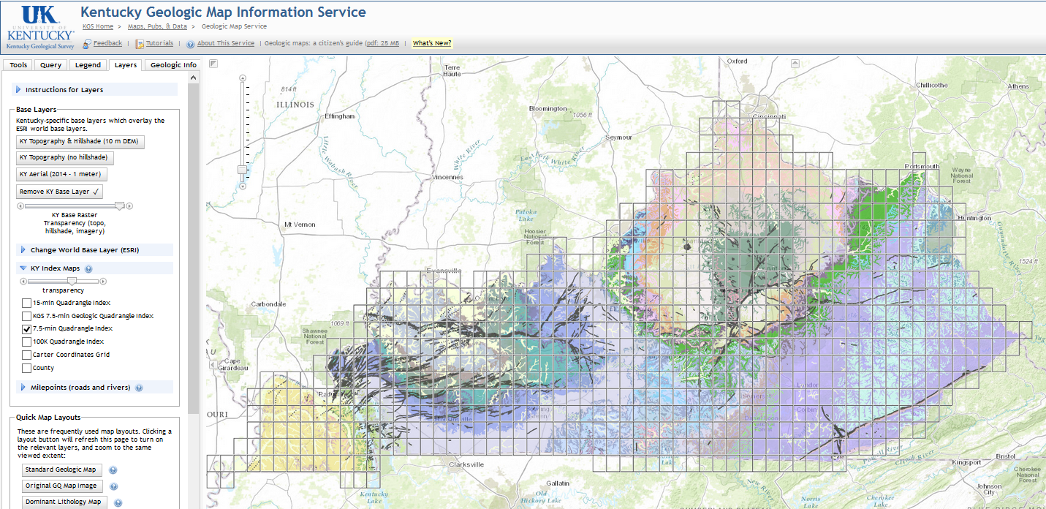
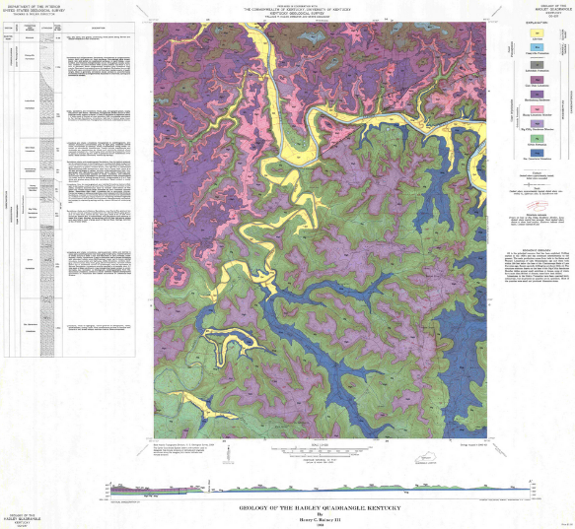
Geologic Mapping in Kentucky
The near-surface bedrock geology is mapped at a very detailed scale (1:24,000, 1 inch = 2000 ft.)

Slide 13

Geologic Mapping in Kentucky
Each map color represents a different geologic unit called a geologic formation
Geologic formations are made up of rock types (e.g. sandstone, limestone, shale)
Rock types have different radon potential depending on the minerals present
In Kentucky radon producing rocks:
• dark shale
• high phosphate sedimentary rocks
(limestone)
Rocks can serve as a source of radon and as a pathway for radon

Slide 14
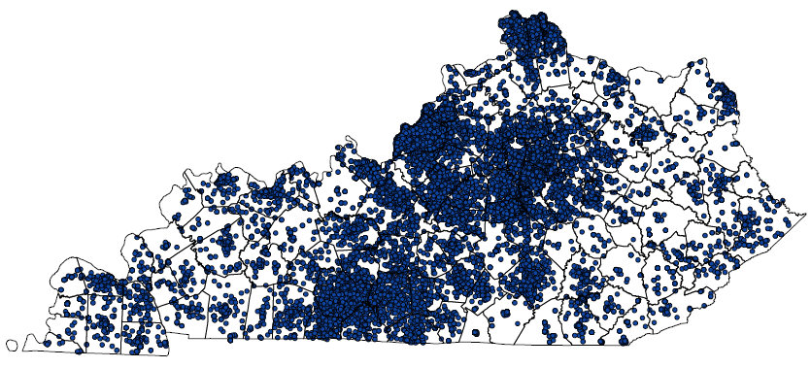
BREATHE team acquired 60K+ residential radon test data points (short term test results)
Addresses converted to lat/long coordinates; duplicates eliminated

Slide 15
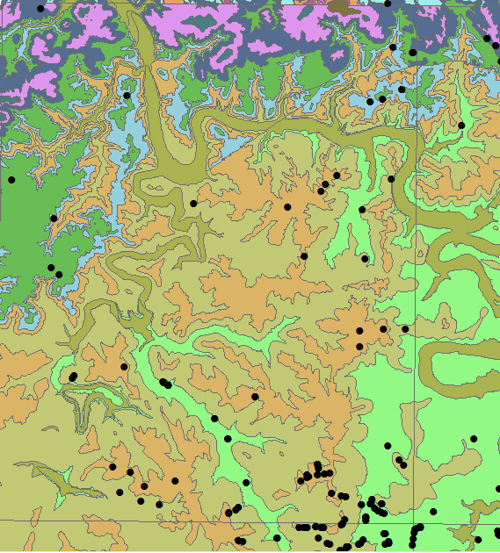
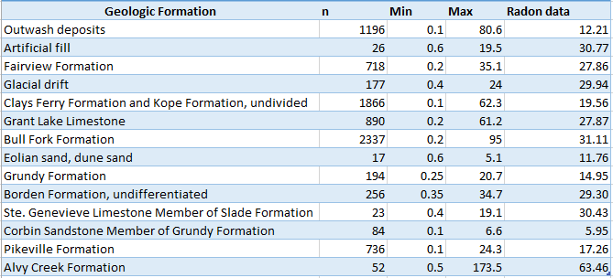
60K+ data point locations intersected with geology
Example data set:
Geologic formation assigned a radon value based on data points within the formation

Slide 16

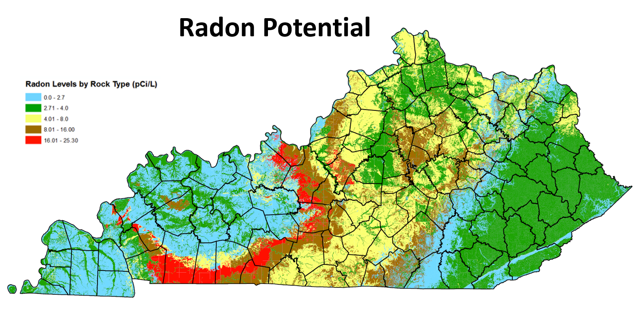
Created a statewide radon potential map
Much more detailed than county-level maps
Show considerable variation within counties

Slide 17

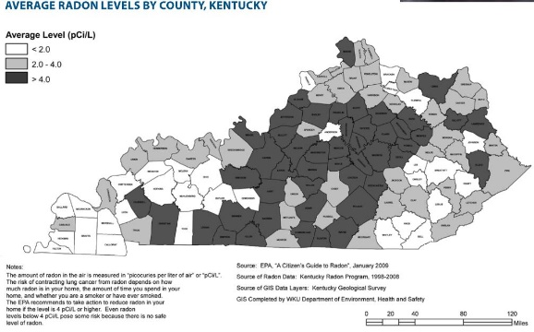
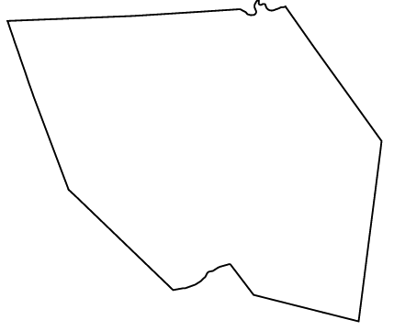

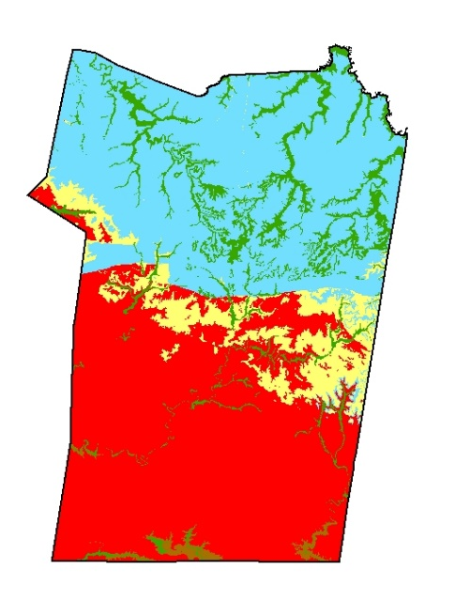
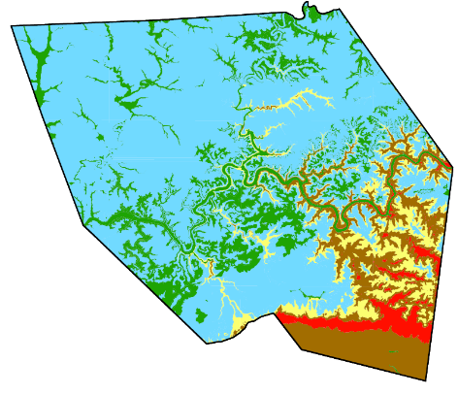
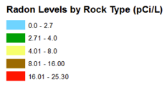
Christian County
Edmonson County
EPA county-level maps
KGS geology-based maps

Slide 18
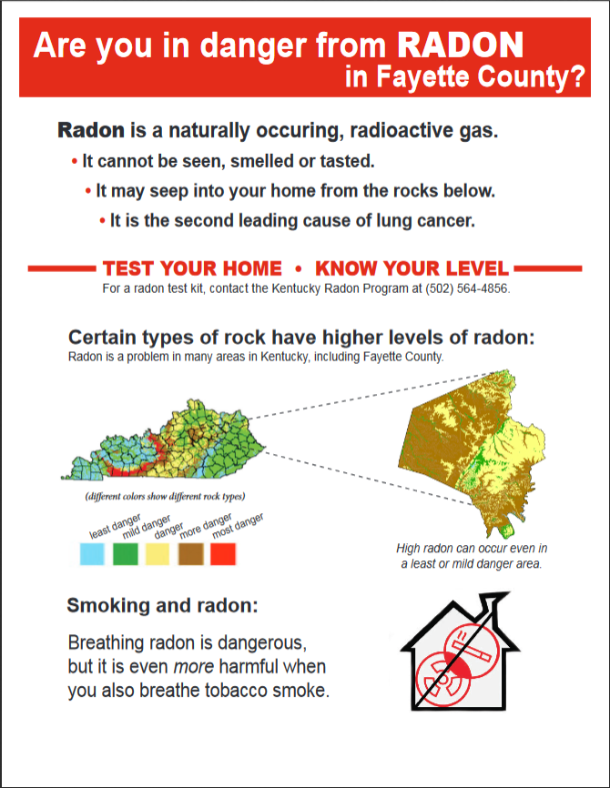
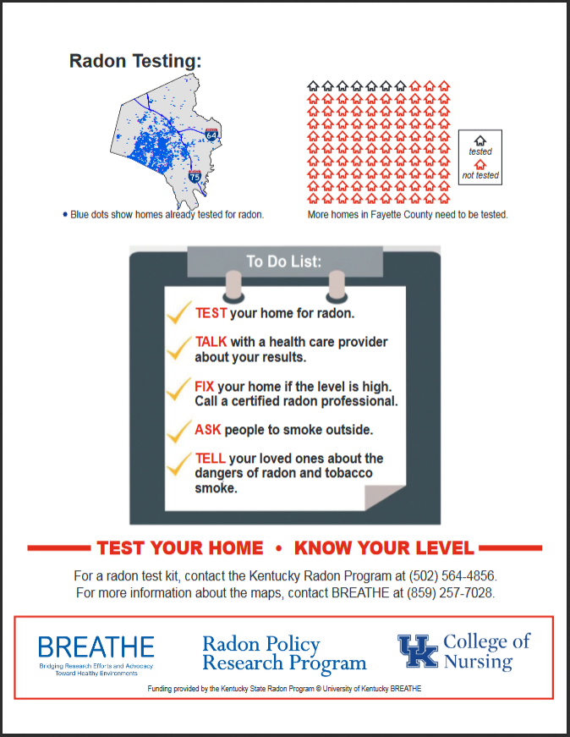
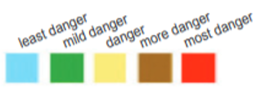
Produced 120 county-based infographics for general public

Slide 19
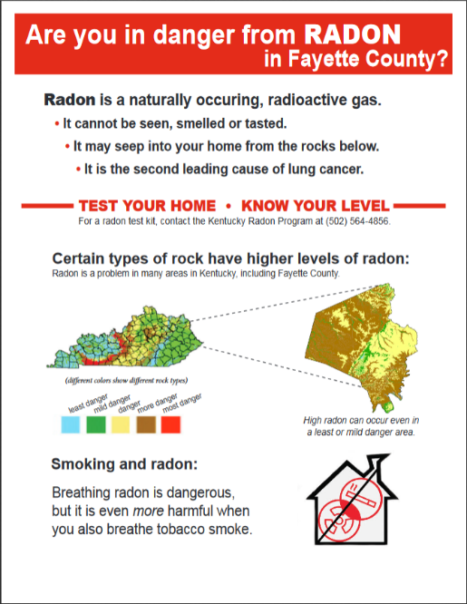
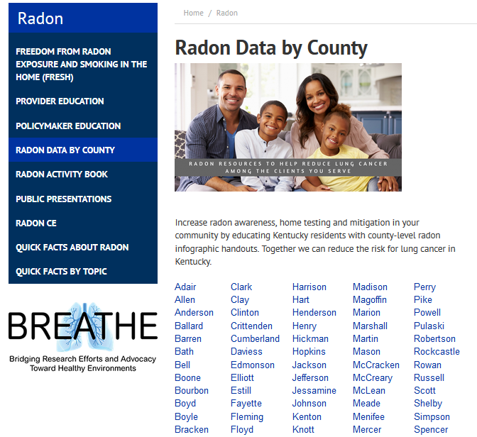
Current maps available on the web by county.

Slide 20
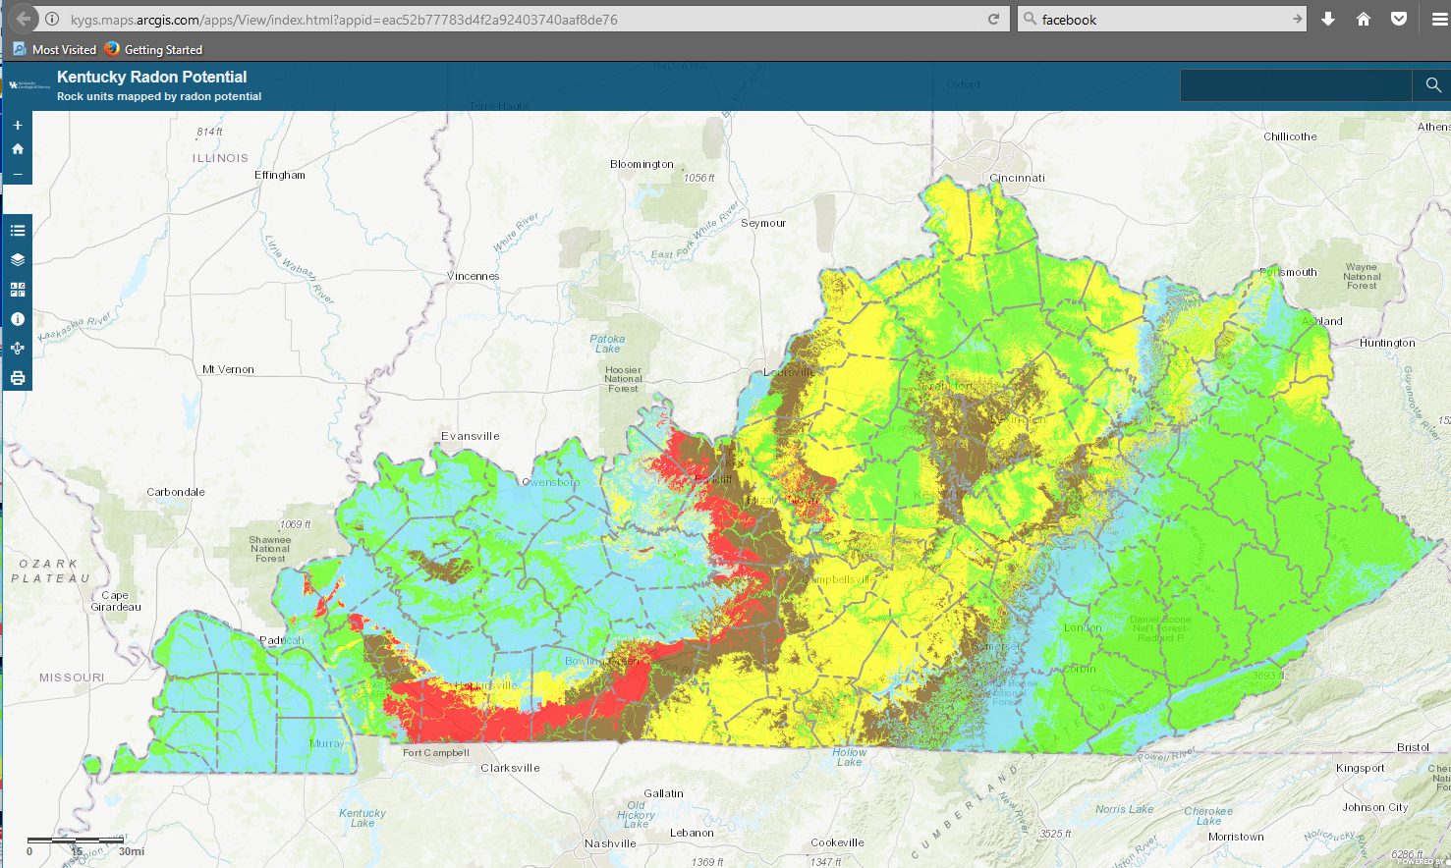
We wanted an interactive way for folks to look at the data that could easily be updated:
Kentucky Radon Potential online mapping service

Slide 21
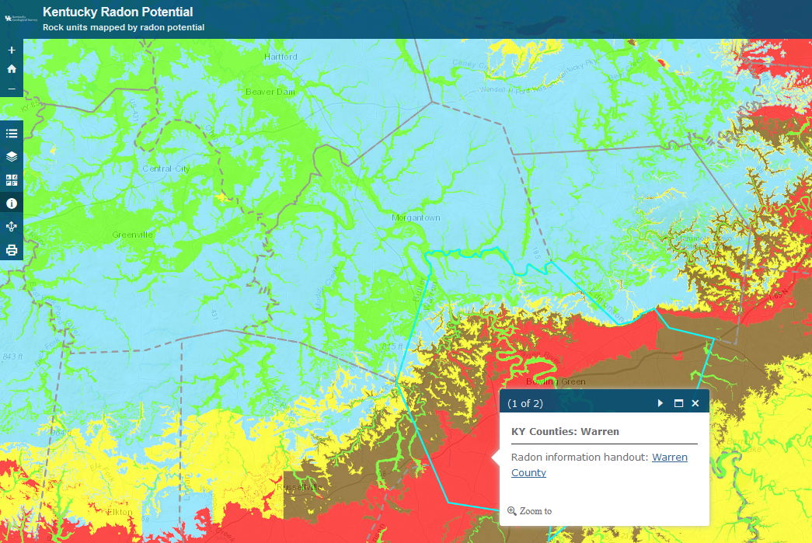
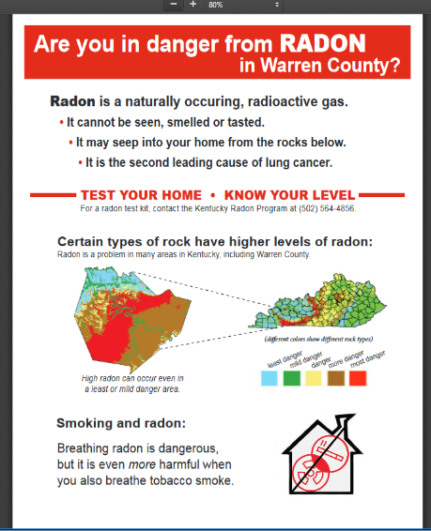
Using the “information (i)” icon, a dialog box is returned with data.
The first page links to the static county infographic

Slide 22
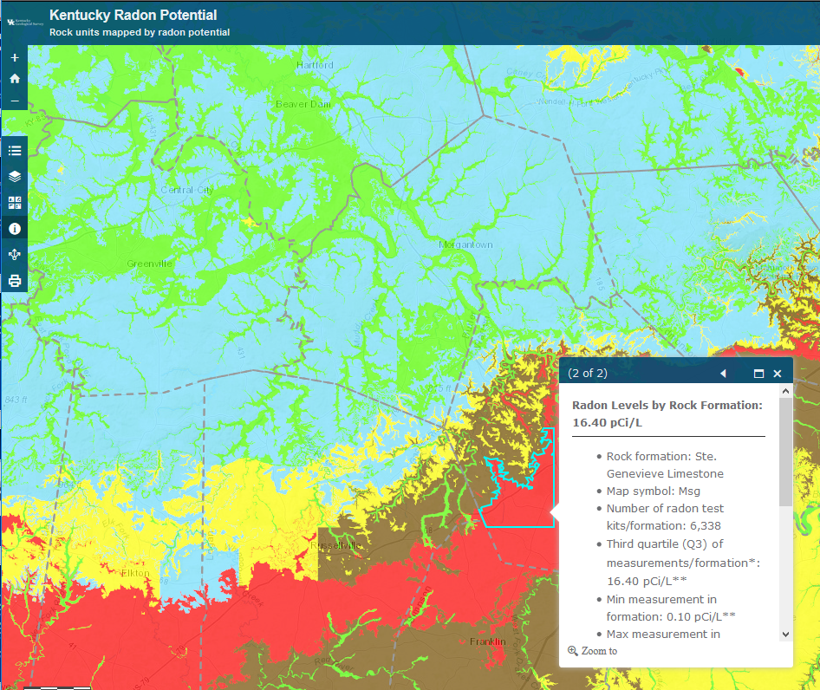
The second page of the dialog box offers information about geology, the number of radon test results in the geologic formation, along with the min, max, and q3 values.

Slide 23
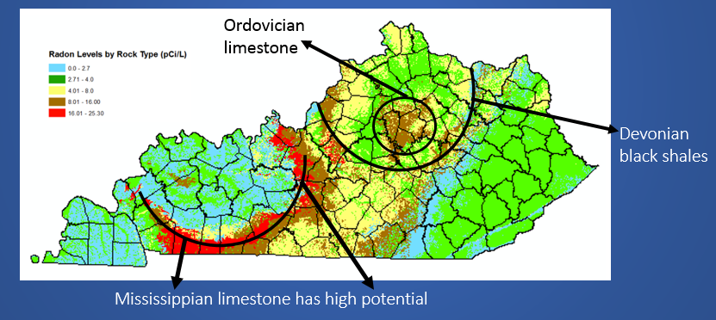
Important questions about geologic control on radon source in Kentucky:
Do KY limestones have different chemical compositions (levels of Uranium) or is high radon in MS limestones due to fractures\karst topography? Or both?

Slide 24
Radon potential maps based on geology are a great starting point, but data set has obvious limitations (lateral variation in a geologic unit, structure of home, residential testing issues).
Future Work
Continue making radon potential maps using new data sources.
-long term tests vs. short term tests ( WE CAN ALWAYS USE MORE DATA!)
Research with existing 60K residential radon data set:
-Climate/seasonal influence on radon gas migration
Life cycle of radon as it pertains to geologic units:
-sample geologic units to assess major, minor, and trace elements using x-ray fluorescence
Validate radon potential maps with new data
-Acquire equipment to take soil-gas samples to verify the county maps
Assess radon in groundwater
Make the online Kentucky Radon Potential mapping service more robust and interactive.

Slide 25
Questions?

